Slide 1



TEAM
KKB

Slide 2


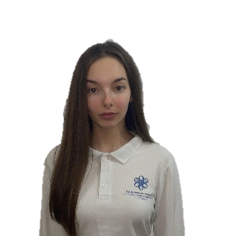

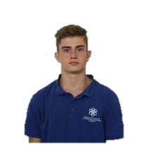

TEAM KKB
Back-end Developer
Scrum Trainer
Front-end Developer
QA Engineer

Slide 3

Purpose
and description
The purpose of our project is to deliver a software for easily grouping the students and teachers in teams in each school
The project represents site where you can find our software which helps to group/regroup the teams

Slide 4





Process
Discuss ideas
Refine
Create a common purpose
Communication
Prioritize work
Document everything in github
Improve time management
Final product

Slide 5


Slide 6





THANK YOU FOR YOUR ATTENTION!

Slide 7
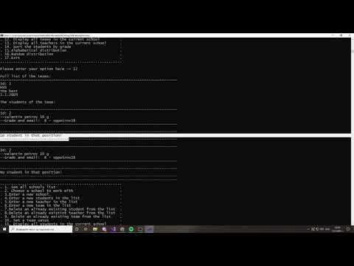

Slide 8


